Slide 1
Introduction to Programming

Slide 2
Contents
Computer programming.
Computer algorithm.

Slide 3
Contents
Computer programming.
Computer algorithm.

Slide 4


Computer programming
Programming concepts:
Problem:
Teach a kid to find sum of max and min among 7, 1, 9.
Rules:
The kid knows addition and comparison between two numbers.
Write solution in step-by-step.
Programming ~ teaching:
From what computer knows.
Step-by-step.
Computer
Programming
Program

Slide 5
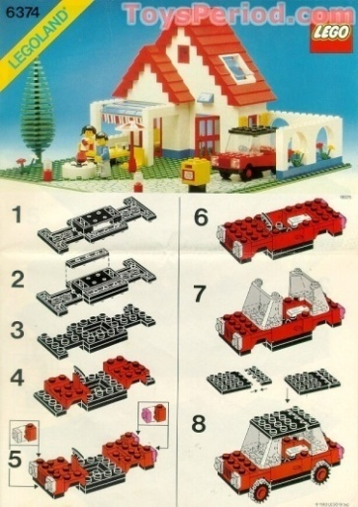

Computer programming
Programming concepts:
Computer has a set of hard-wired instructions.
Programming: write instructions for computer.
Computer program:
Written organized instructions.
Follow step-by-step.
To solve problem.

Slide 6
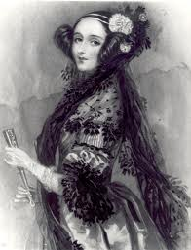

Computer programming
Programmer:
Person who writes the program.
Programmer, coder, developer.
To become a good programmer:
Logical thinking.
Analytical and careful.
Hands-on and explore.
The first programmer?
Ada Lovelace

Slide 7

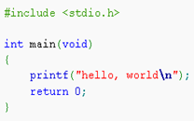
Computer programming
Instruction code:
Machine code:
Binary sequence of ‘0’ and ‘1’.
Computer can execute directly.
Pseudo-code:
Natural language.
Human can understand.
Source code:
Intermediate language.
Easy to read, not too vague.
Can be translated to machine code.
Compiler vs. Interpreter.
Who wrote the first compiler?
Step 1: add a, b.
Step 2: compare a, c.
Step 3: output a.
…

Slide 8



Computer programming
Programming cycle:
Edit: write source code.
Compile: source code 🡪 machine code.
Run: execute machine code to perform tasks.
Debug: review source code to fix errors.
🡺 Debug takes the most time!
Edit / Debug
Compile
Run

Slide 9

Computer programming
Programming language:
Intermediate language between human and computer.
Concise and precise.
There are thousands of programming languages!
Learning programming thinking is more important than learning programming language.

Slide 10
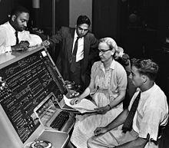
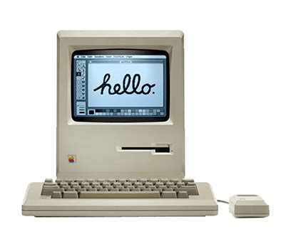

Computer programming
Programming language:
Low-level language:
1st generation: machine code.
2nd generation: assembly language.
High-level language:
Procedural: Fortran, Pascal, C.
Functional: Lisp, Haskell, F#.
Object oriented: C++, Java, C#.
Trends:
Scripting languages: JavaScript, Python.
AI prompts: ask AI to generate source code.

Slide 11
Computer programming
Programming environment:
A platform of tools supporting programming tasks.
Source code editor:
Edit text, syntax highlight, code completion.
Compiler:
Translate source code to machine code.
Terminal:
Command-line tool to run program and shell commands.
Debugger:
Run program step-by-step.
Monitor computer memory.

Slide 12

Computer programming
Programming environment:
IDE – Integrated Development Environment:
A single application combining programming tools all-in-one.
User friendly, configuration-free, add-in features.
Cons:
Heavy memory and storage usage.
Limit configuration skill.
Require license.
Track user data.

Slide 13
Computer programming
C/C++ programming environment:
(*): Proprietary software and track user data.
(+): Run on Linux simulated environment like MinGW64, WSL.
Tools | Windows | MacOS | Linux
Editor | Notepad++ VS Code (*) Sublime Text (*) | TextMate VS Code (*) Sublime Text (*) | Vim, Emacs VS Code (*) Sublime Text (*)
Compiler | MSVC (*) GCC (+) Clang (+) | Clang GCC | GCC Clang
Debugger | MSVC (*) GDB | LLDB GDB | GDB LLDB
IDE | Visual Studio (*) Code::Blocks CodeLite | Xcode (*) Code::Blocks CodeLite | Code::Blocks CodeLite

Slide 14
Computer programming
C/C++ programming environment:
Set up loosely-coupled environment:
Windows: MinGW64, GCC, GDB.
Project WinLibs: light-weight, not extensible, https://winlibs.com
Project MSYS2: get MSYS2 and toolchain, https://www.msys2.org
Linux (Ubuntu/Debian): GCC, GDB.
Install package build-essential.
MacOS: Clang, LLDB.
Terminal command: xcode-select --install.
Set up IDE:
Visual Studio (Windows): https://visualstudio.microsoft.com
Xcode (MacOS): xcode-select --install, then Get Xcode.
Code::Blocks: https://www.codeblocks.org
CodeLite: https://codelite.org

Slide 15
Contents
Computer programming.
Computer algorithm.

Slide 16
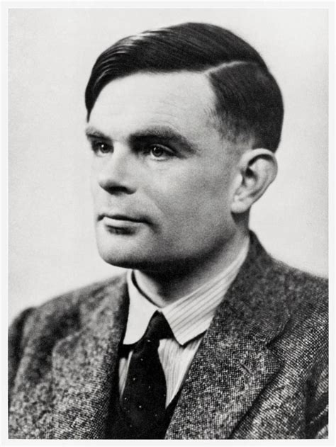
Computer algorithm
Algorithm concepts:
Different machines have different instruction code.
Turing machine: abstract machine and instructions.
Algorithm ~ program on Turing machine:
Finite steps to solve problem on Turing machine.
Does not depend on specific machine.
Is more abstract than program.
Alan Turing

Slide 17
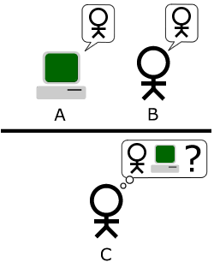
Computer algorithm
Algorithm basic instructions:
Read input, write output.
Arithmetic operations: +, -, *, /, =.
Comparisons: >, <, >=, <=, ==, !=.
Condition: if-else.
Loop: while.
Can machines think?
The Imitation game - Turing test.

Slide 18
Computer algorithm
Algorithm representations:
Pseudo-code:
Use natural language.
Notations:
Instructions | Notations | Example
Read input Write output | Input Output | Step 1: Input a, b, c. Step 2: Output a + b + c.
Arithmetic operations | +, -, *, /, %, = | -Step 1: a = 5. -Step 2: b = (a + 5) / (a – 3).
Condition | If <condition> … Else … | -Step 1: Input a. -Step 2: If a < 0 Output “Negative” Else Output “Positive”.
Loop | While <condition> ... | -Step 1: a = 0. -Step 2: While a < 10 Output a. a = a + 1.

Slide 19
Computer algorithm
Algorithm representations:
Pseudo-code:
* Find max among 3 numbers:
-Step 1: Input a, b, c.
-Step 2: max = a.
-Step 3: If b > max max = b.
-Step 4: If c > max max = c.
-Step 5: Output max.
* Compute factorial of N:
-Step 1: Input N.
-Step 2: S = 1.
-Step 3: While N > 1 S = S * N. N = N – 1.
-Step 4: Output S.

Slide 20
Computer algorithm
Algorithm representations:
Flowchart:
Use diagram.
Visualize flow of process.
Notations:
Intrustions | Notations | Example
Read input Write output
Arithmetic operations
Condition
Transition
a, b, c
x, y
a = a + b
a < 0

Slide 21
Computer algorithm
Algorithm representations:
a, b, c
N
max = a
S = 1
b > max
true
false
max = b
N > 1
false
true
true
S = S * N
c > max
max = c
false
N = N - 1
max
S

Slide 22
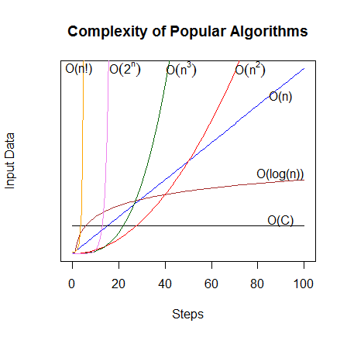
Computer algorithm
Algorithm efficiency:
Complexity:
Algorithm performance varies with different inputs.
Big-O notation: O(), growth rate.
Time complexity: input ~ instructions.
Space complexity: input ~ memory.
Classes of complexity:
Constant: O(1).
Logarithmic: O(log(n)).
Linear: O(n).
Polynomial: O(n^2), O(n^3), …
Exponential: O(2^n).
Factorial: O(n!).

Slide 23
Computer algorithm
Algorithm efficiency:
Popular algorithm complexities:
Simplicity:
Easier to understand and implement.
Reduce cost in debugging and maintenance.
Algorithm | Complexity | Form
Finding max (3 numbers) | O( 1 ) | Constant
Binary Search(N elements) | O( log(n) ) | Logarithmic
Factorial N! | O(n) | Linear
Sorting (N elements) | Bubblesort: O( n² ) Quicksort: O( n*log(n) ) | Polynomial
Traveling Salesman (N city) | O (K^{n} ) O( n! ) | Exponential Factorial

Slide 24
Summary
Computer programming:
Write instructions for computer to solve problem.
Programming cycle: edit, compile, run, debug.
Programming language:
Intermediate language to communicate with computer.
Low-level vs high-level.
Trends: scripting languages, AI prompts.
Programming environment:
Platform of tools supporting programming tasks.
Editor, compiler, terminal, debugger.
IDE: Integrated Development Environment.

Slide 25
Summary
Computer algorithm:
Finite steps to solve a problem on Turing machine.
Turing machine: abstract machine and instructions.
Basic instructions:
Input, output.
Arithmetic operations, comparisons.
Condition, loop.
Representations: pseudo-code, flowchart.
Efficiency:
Complexity: Big-O notation, growth rate.
Simplicity: easy to understand or implement.

Slide 26
Practice
Practice 1.1:
Write algorithm to compute person age as follow:
- Input person birth-year.
- Compute and output person age.

Slide 27
Practice
Practice 1.2:
Write algorithm to compute lucky number of a car as follow:
- Input car registration number (a 5-digit number).
- Compute and output the lucky number.

Slide 28
Practice
Practice 1.3:
Write algorithm to simulate a calculator as follow:
- Input two integers.
- Input an operation (+, -, *, /).
- Perform the operation on two integers and output result.

Slide 29
Practice
Practice 1.4:
Write algorithm to rank a student as follow:
- Input literature, math, physics points.
- Calculate student GPA.
- Rank student based on GPA:
+ Excellent: GPA >= 8.5.
+ Good: GPA >= 7.0.
+ Fair: GPA >= 5.0.
+ Failed: GPA < 5.0.
- Output GPA and rank.

Slide 30
Practice
Practice 1.5:
Write algorithm to count number of days in a month as follow:
- Input a month and a year.
- Count number of days in that month and output result.

Slide 31
Practice
Practice 1.6:
Write algorithm to compute exponentiation of an integer as follow:
- Input x and n.
- Compute x^{n} and output result.

Slide 32
Practice
Practice 1.7:
Write algorithm to do the following:
- Input 2 integers x, n (n > 0).
- Calculate and output S = x + x² + … + x^{n}.

Slide 33
Practice
Practice 1.8:
Set up a C/C++ programming environment on your computer.

Slide 34
Practice
Practice 1.9:
Edit, compile and run the following C/C++ program.
What does the program ask for?
What does the program print to screen?
#include <stdio.h> int main() { int a, b, c, max;
printf(“Enter 3 integers = “); scanf(“%d %d %d”, &a, &b, &c);
max = a; if (b > max) max = b; if (c > max) max = c;
printf(“max = %d”, max); }

Slide 35
Practice
Practice 1.10:
Edit, compile, run and debug the following C/C++ program.
a) What does the program ask for and print to screen?
b) When enter n = 10, list the values of s when n = 3.
#include <stdio.h> int main() { int n; long long s;
printf(“Enter an integer = “); scanf(“%d”, &n);
for (s = 1; n > 0; n--) s = s * n; printf(“Factorial = %lld “, s); }

